Slide 1
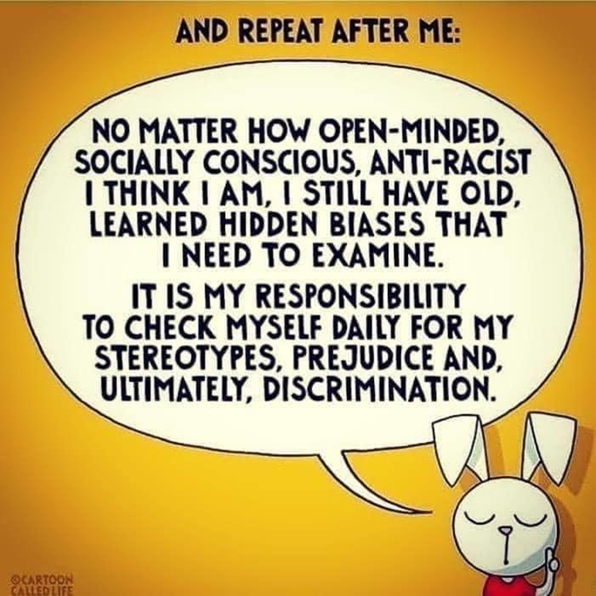
What Can Volunteer Managers Do About Racism? Part 2
A Volunteer Management Roundtable
Presented by Volunteer Fairfax
October 8, 2020
2 pm – 3 pm

Slide 2
Ground rules
This is a 60-minute discussion. We are here to guide you to issues -- not necessarily solutions -- to recognize and end racism. Please be respectful of others.
Feel free to keep the microphones open, but be ready to put us on mute should you have unexpected noises.
Ask questions in the chat area or via your microphone. Be respectful if more than one person tries to talk at one time.
The webinar will end no later than 3:00 pm. I will stay on the line should you have any additional volunteer management issues to discuss.
The PowerPoint slides will be sent to you within 24-hours after the webinar.

Slide 3
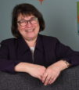
Presenters
Jerome Tennille, CVA, MSL
Manager, Social Impact &
Volunteerism
Marriott International
Susan Sanow
Special Projects Manager,
Volunteer Fairfax

Slide 4
Since we last talked about this issue …

Slide 5
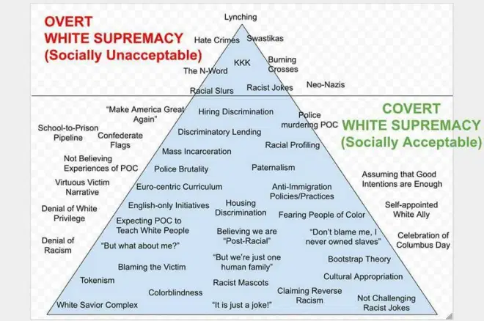
Actions of Active vs. Covert Racism

Slide 6
The Nonprofit Sector: Who Holds the Power and Acts as Gatekeepers
Executive director
Board of directors
Funders (foundations, government, corporations, individuals, others)
“Keep quiet to keep nonprofit status?”
Paid staff vs. unpaid volunteers
Volunteers who are also donors
“Like society looking at addressing racial inequalities, there are inherent power imbalances in society. This goes for [nonprofit] organizations, too.”
--Tobi Johnson

Slide 7
Volunteering is a path to battle racism because we…
together, build empathetic pathways
push people outside comfort zones
breakdown barriers
build knowledge
provide opportunities to put name, faces and true stories to an issue

Slide 8
Why Volunteer Managers Can Help?
Empathetic.
Curious.
Brave.
Problem solvers.
At the front line.
We establish policies.
We establish practices.
Can we work to create transformative volunteer opportunities?

Slide 9
What’s Changed for YOU Since June 2020?
See more examples?
Attended other webinars?
Read articles or books?
Has your perspective changed?

Slide 10
Is There a Call to Action?
By you
By your volunteer program
By the leadership in your organization
What’s the reaction?

Slide 11
Roundtable Moderators Reflect on Systemic Racism in Volunteer Engagement by Jayne Cravens
Reactions
Claims or paragraphs that stood out? If so, why?
Before reading this article, have you thought about how institutions are founded and how they may contribute to injustices?

Slide 12
Your Reflection on the Article
Initial reactions? A-Ha moments?
Specific claims or paragraphs that stood out? if so, why?
Before reading this article, have you thought about how institutions are founded and how they may contribute to injustices?

Slide 13
Next Steps for a Volunteer Manager
Is there
one action
you can commit to moving forward?

Slide 14
Future Roundtable?
Blindspot: Hidden Biases of Good People

Slide 16
Upcoming FREE Webinars from Volunteer Fairfax in October-November 2020
Northern Virginia Association of Volunteer Administrators (NVAVA)
AND Volunteer Fairfax present:
Celebrate
International Volunteer Managers Day Virtual Luncheon!
Thursday, November 5
12 noon – 1 pm
https://vmd1152020.eventbrite.com
Empowering Volunteers to Lead
Thursday, October 15, 9:30 – 10:30 am
https://vfoctober152020.eventbrite.com
The Volunteer Manager’s Essentials:
Policies, Documents, Data and More.
Wednesday, October 21, 9:30 – 10:00 am
https://vfoct212020.eventbrite.com
Volunteer Management Roundtable
Conversation to Action: The Volunteer 2020 Covid
Nonprofit and Volunteer Engagement Survey
Tuesday, October 27, 2 pm – 3 pm
https://vfoct272020.eventbrite.com

Slide 17
Thank you. Please provide your Roundtable feedback: https://www.surveymonkey.com/r/9FVKZXL
Susan Sanow
ssanow@volunteerfairfax.org
Jerome Tennille, CVA, MSL
jdtennille@jerometennille.com

